Slide 2
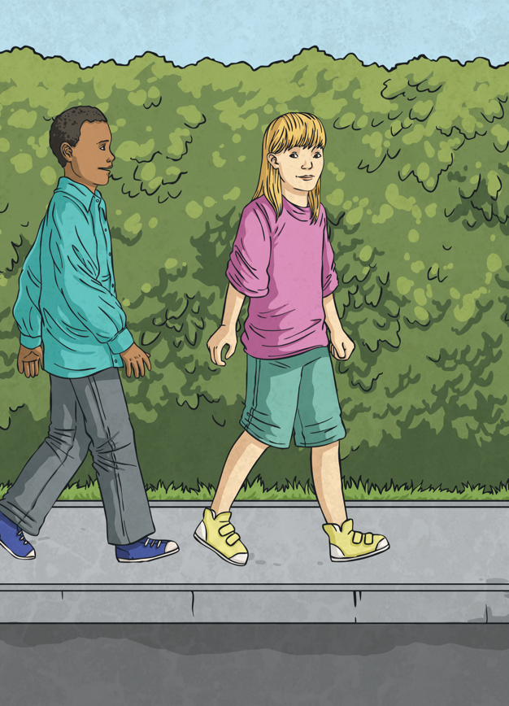
What Is Road Safety Week?
Road Safety Week happens every year in November and is the UK’s biggest road safety event, organised by the charity ‘Brake’.
Road Safety Week inspires schools, businesses and communities all around the country to get involved to learn and spread the word about road safety.
This year, the theme is Let’s Talk About... SPEED.

Slide 3

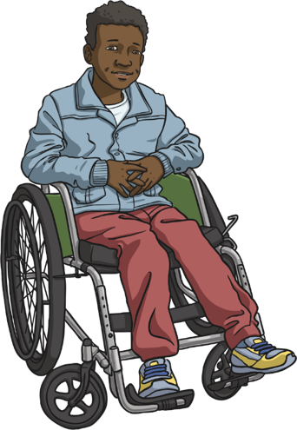
Why Do We Need It?
Brake started Road Safety Week in 1997 to raise awareness of road safety in order to cut the number of injuries and deaths on roads.
Deaths and injuries from road accidents have gone down since 1997 but more
still needs to be done to keep
the numbers going in the
right direction.

Slide 4
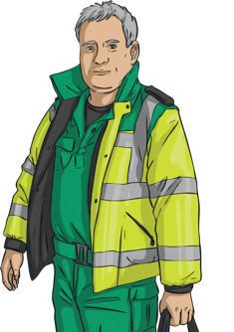
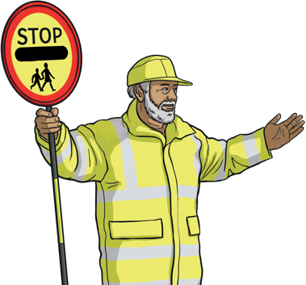
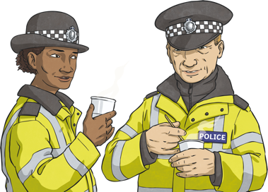
There Is No Need to Speed
The aim of Road Safety Week is to learn how to stay safe around, on and near the road.
When traffic moves slowly, pedestrians, cyclists and drivers are safer. The slower the traffic, the quicker it can stop. If we drive faster than the speed limit, or too fast for the road conditions, we increase the risk of a crash!
Can you think of some job roles that help to keep our roads safe?
Police
Paramedic
Crossing Patrol Officer

Slide 5
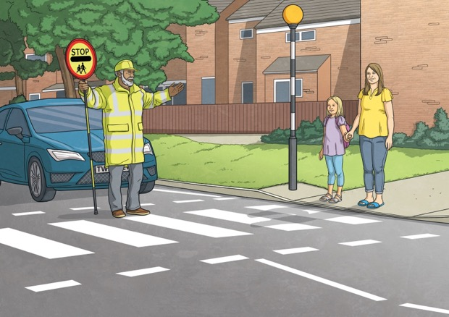
There Is No Need to Speed
Every four minutes, someone is seriously hurt on roads in the UK.
We all have a responsibility to make our journeys as safe as possible.
The stopping distance at 20mph is 12 metres (or 3 car lengths).
The stopping distance at 30mph is 23 metres (or 6 car lengths).
Which is safer?

Slide 6


There Is No Need to Speed
Did You Know…?
Maximum speed limit signs on the road are white with a red outline.
Minimum speed limit signs often have blue circles.

Slide 7

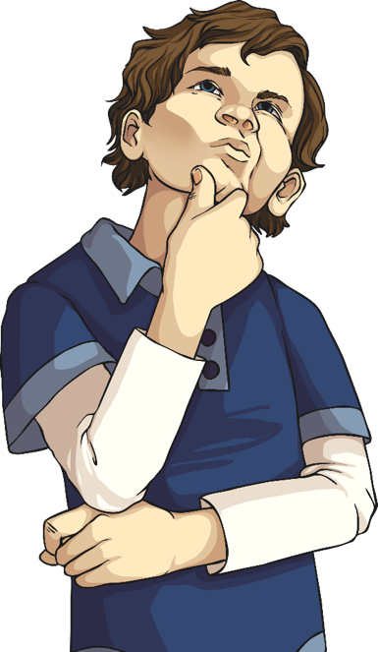


What Can We Do? The ABCs
Awareness
Behaviour
Choice

Slide 8

Awareness
Traffic is Dangerous!
On UK roads, 136,002 casualties were reported in 2022, of which:
over 106,300 were classified as slight injuries;
over 29,700 were killed or seriously injured;
almost 1700 people died.
In 2022, the number of accidents in cars was around 74,800, pedestrians 19,380, motorcyclists 16,960 and cyclists 15,690.
What do you think about these numbers?

Slide 9
Awareness
Being Distracted
What might distract you when you are walking or cycling? | What might distract someone or affect their driving?
texting phone ringing games on mobile phones taking photos talking singing skates or scooters something on the pavement | texting talking on the phone smoking eating drinking listening to music arguing speeding other people in the car doing something for a child road rage alcohol

Slide 10

Behaviour
How Do You Stay Safe?
Pelican Crossing
(with traffic lights and a green man)
Footbridge
Barriers
Think of as many things as you can that we have to make crossing roads safer.
Traffic Island
Underpass
Zebra Crossing
(no traffic lights but black and white stripes on the road and Belisha beacons)
Toucan Crossing
(‘Two Can Cross’ for pedestrians and cyclists with traffic lights)
Equestrian Crossing
(for pedestrians and horse riders
with traffic lights)
Puffin Crossing
(Pedestrian User Friendly Intelligent)
Same as a pelican but with added sensors to detect speed of pedestrians

Slide 11

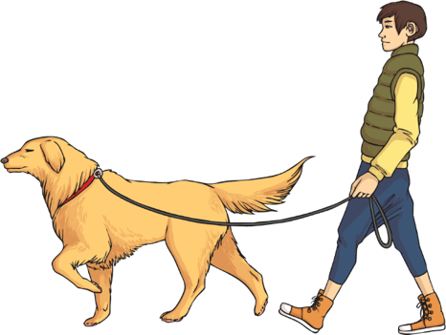
Behaviour
The Green Cross Code
Think – where is safe to cross?
Stop.
Look and Listen.
Wait until it is safe to cross.
Look and Listen as you cross.
Walk across the road, don’t run.

Slide 12
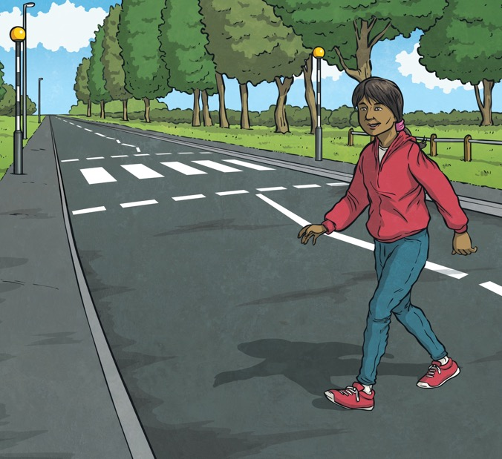
Behaviour
Other Behaviours
Always try to use a pedestrian crossing when possible.
Try not to cross the road from between parked cars, or near trees and bushes, as drivers might not be able to see you.
Avoid crossing near a bend.

Slide 13
Behaviour
Questions
At which side should you get out of a car?
Reveal answer
Answer: The pavement side where possible.
After getting off a bus, when should you cross
the road?
Reveal answer
Answer: After the bus has moved away.

Slide 14

Choice
What to Wear
What to wear when walking | What to wear when cycling
What to Wear When Walking | What to Wear When Cycling
hi-vis jacket bright and reflective colours in the dark fluorescent (not reflective) colours show up in the daytime flat shoes laces done up reflectors on your bag | helmet reflective gear lights and reflectors on bikes no loose laces
What should you always wear in a car?

Slide 15
How Much Do You Know?
What is the speed limit outside school?
Reveal answer
Answer: 30mph in built-up areas although some local councils can set speed limits outside schools to 20mph.
What should you always wear in a car and why?
Reveal answer
Answer: A seat belt because it stops you from being thrown forward in a crash.
Why should you reduce your speed in wet or frosty weather?
Reveal answer
Answer: It takes double the amount of time to stop in wet weather because your tyres will have less grip on the road. It takes up to ten times longer to stop in snow or ice. Reduce your speed and leave more space between you and the vehicle in front to account for greater stopping distances.

Slide 16

How Much Do You Know?
Which of these things shouldn’t you do when being a passenger in a car?
  Throw things in or out of the car.
  Lean out of the window.
  Block the driver’s view of the window or mirror.
  Argue or shout loudly.
Answer: All of these things!
Reveal answer

